Slide 1
C# & .NET Framework
Chapter 7: Interfaces and Collections
Chapter 8: Delegates and Events
Chapter 10: Understand Generics

Slide 2
Chapter 3: Review
Member visibility: public, private, protected, internal, protected internal
Types (classes, interfaces, structures, enumerations, and delegates) are limited to public or internal (default).
All constant fields are implicitly static
Read-only fields are not implicitly static
Static constructor
Method parameter modifiers: out, prams, ref
Value types & reference types
Boxing & un-boxing
System.Object: toString(), equal()

Slide 3
Chapter 4: Review
Encapsulation
Inheritance
Polymorphism: virtual vs abstract
Casting rules:
Value types:
Convert smaller type to bigger type: OK (also called implicit cast)
Convert bigger type to smaller type: NOT OK => need an explicit cast => may cause loss of data
Reference type
Convert sub-class to supper class: OK (also called implicit cast)
Convert supper class to sub-class: NOT OK => need an explicit cast => may cause run time error

Slide 4
Chapter 7: Objectives
Defining Interfaces in C#.
Implementing an Interface in C#
Building Interface Hierarchies.
Building Enumerable Types (IEnumerable and IEnumerator)

Slide 5
Defining Interfaces in C#
By convention, interfaces in the .NET base class libraries are prefixed with a capital letter “I.”
// This interface defines the behavior of "having points."
public interface IPointy
{
// Implicitly public and abstract.
byte GetNumberOfPoints();
}
It is impossible to create an instance of an interface
IPointy p = new IPointy(); // Compiler error!

Slide 6
Implementing Interfaces in C#
// This class derives from System.Object and
// implements a single interface.
public class SomeClass : ISomeInterface
{...}
// This class also derives from System.Object
// and implements a single interface.
public class MyClass : object, ISomeInterface
{...}
// This class derives from a custom base class
// and implements a single interface.
public class AnotherClass : MyBaseClass, ISomeInterface
{...}

Slide 7
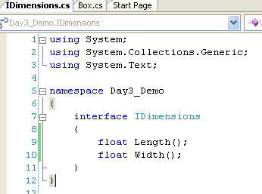
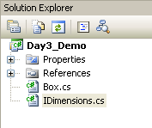
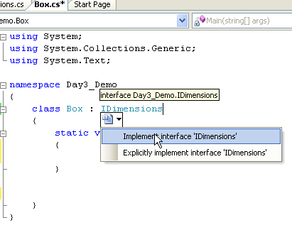
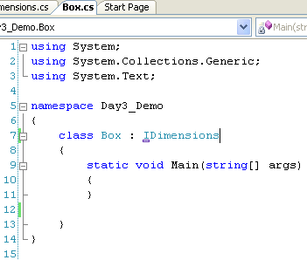
Interface Demo in VS 2005
Click small box here

Slide 8
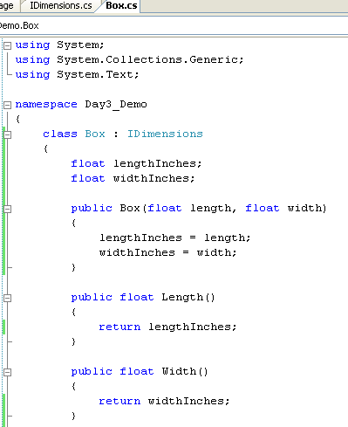
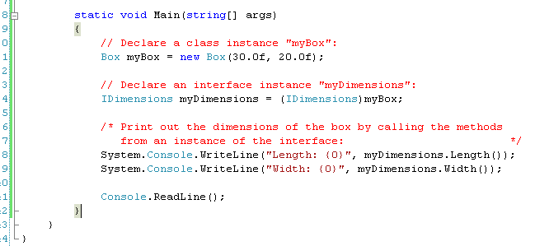


Slide 9
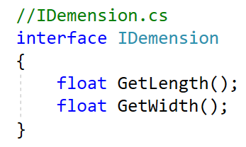
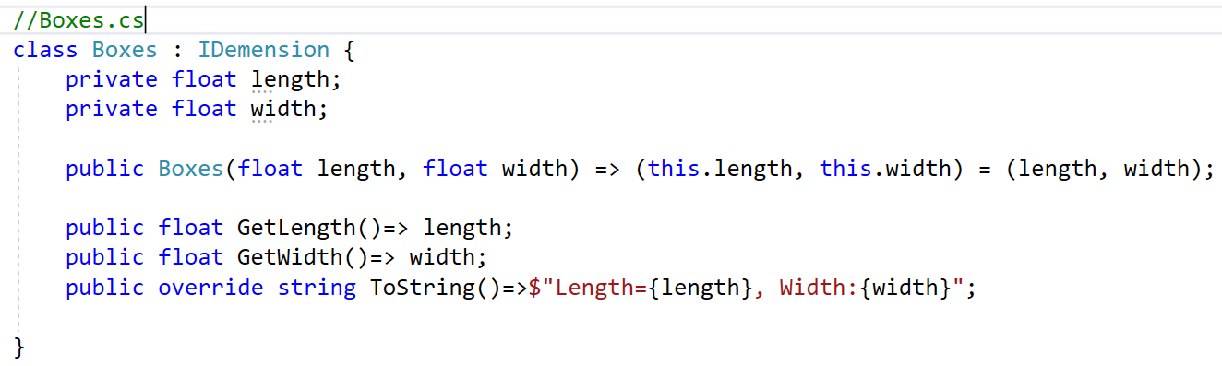
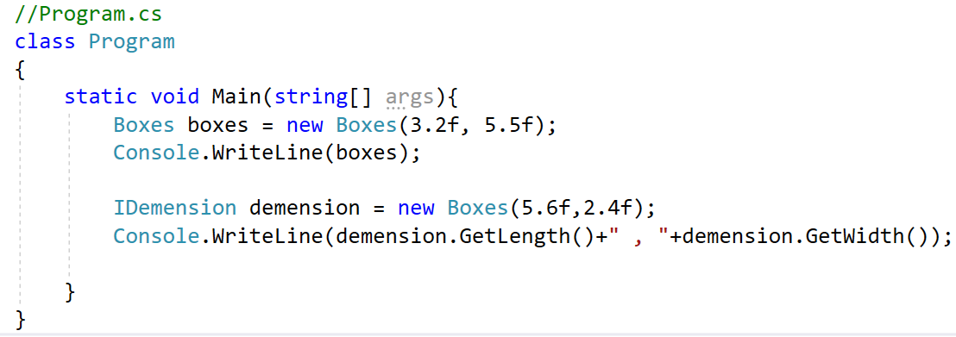

Slide 10
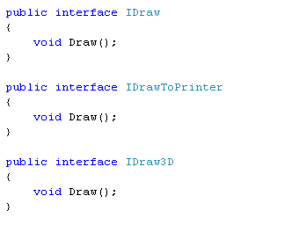
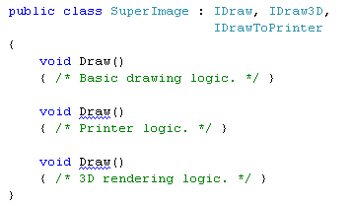
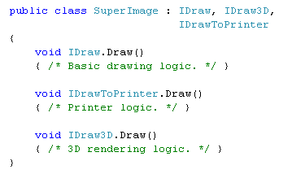
Resolving Name Clashes
error
error

Slide 11
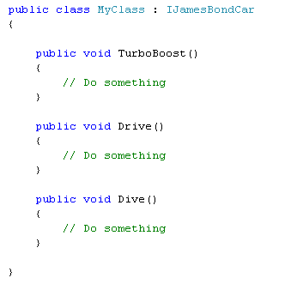
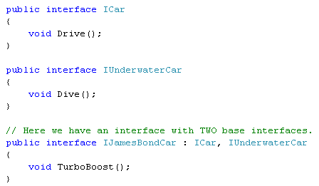
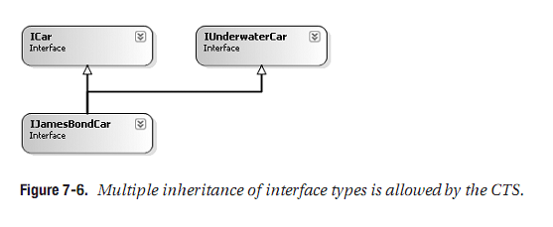
Multiple Base Interfaces

Slide 12
Collections Interfaces
Interface | Description
ICollection<T> | Base interface for generic collections.
IEnumerator<T> IEnumerable<T> | Enumerates through a collection using a foreach statement .
IComparer<T> IComparable<T> | Compares two objects held in a collection so that the collection can be sorted.
IList<T> | Used by array-indexable collections.
IDictionary<K,V> | Used for key/value-based collections such as Dictionary.

Slide 13
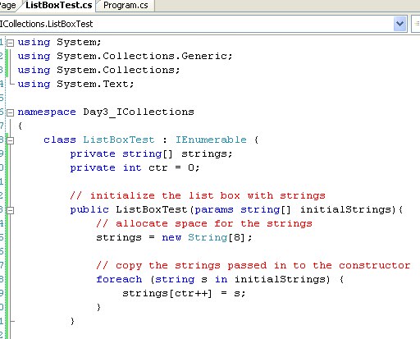
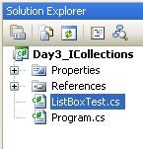
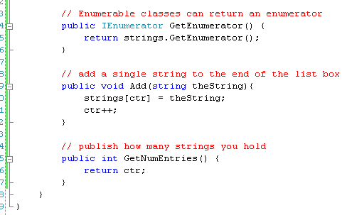
The IEnumerable<T> Interface
Add this

Slide 14
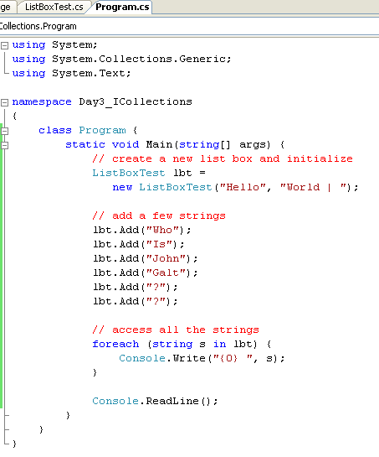

The IEnumerable<T> Interface

Slide 15
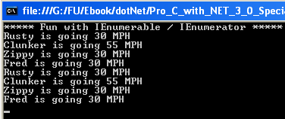
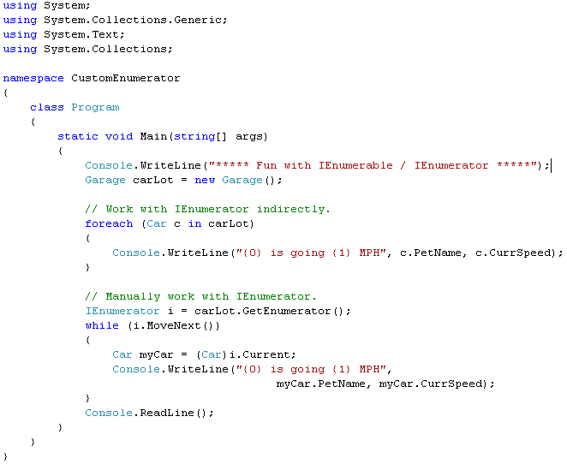
Another example on Enumerable….
How can an object of a class act as a collection???

Slide 16
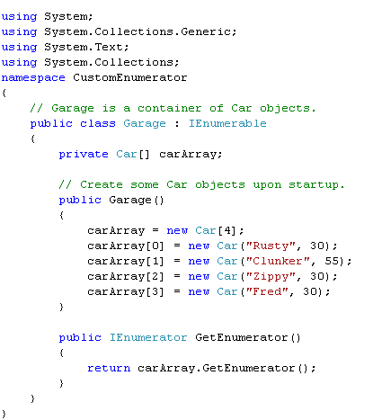
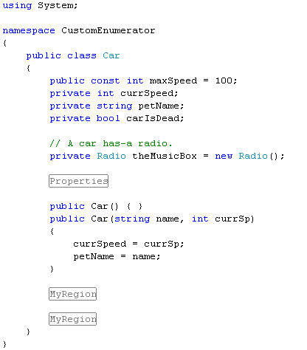
Another example on Enumerable….
Here is the SOLUTION
overridden
From now on, Garage class can act as a collection of Car object

Slide 17
Enjoy yourself
ICloneable
IComparable
(Allow to make a copy (shallow) of an object)
(Allow to compare 2 object based on
certain conditions)

Slide 18
Chapter 7: Q & A

Slide 19
Chapter 8: Delegates and Events

Slide 20
.NET Delegate Type
A delegate type maintains three important pieces of information:
The name of the method on which it makes calls
The arguments (if any) of this method
The return value (if any) of this method
// This delegate can point to any method,
// taking two integers and returning an integer.
public delegate int BinaryOp(int x, int y);

Slide 21
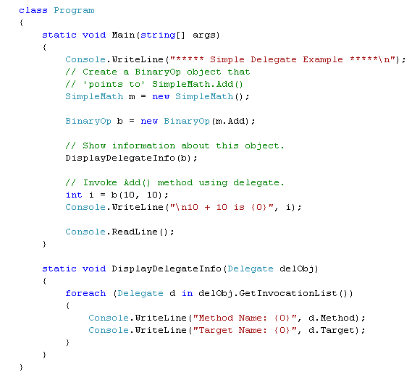
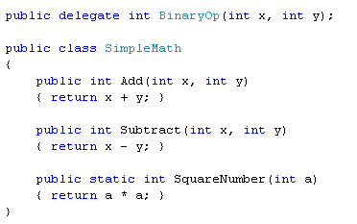
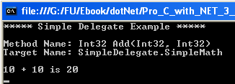
Delegate Demo
Register method
Invoke method

Slide 22
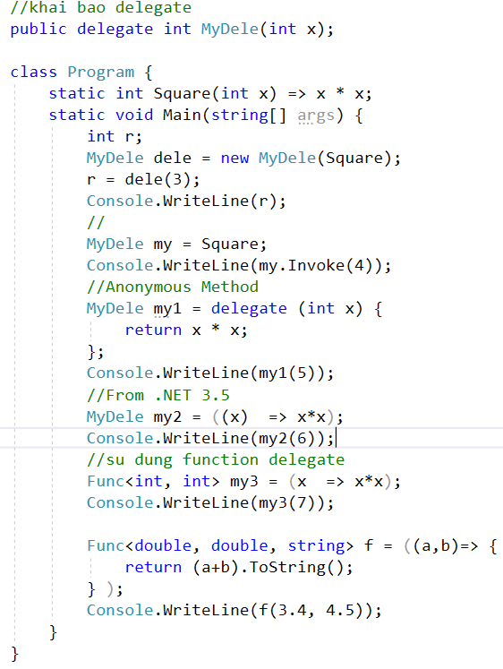

Slide 23
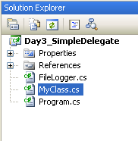
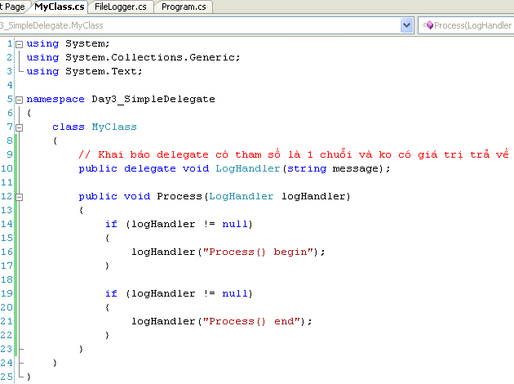
Delegate As function parameters Demo

Slide 24
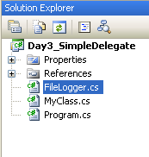
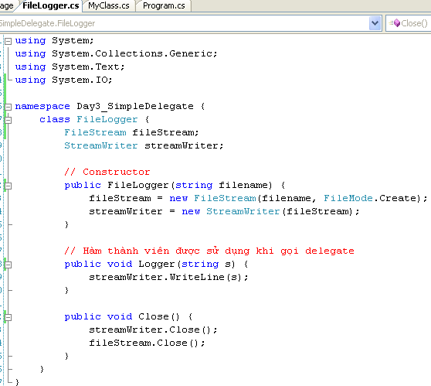
Delegate As function parameters Demo….

Slide 25
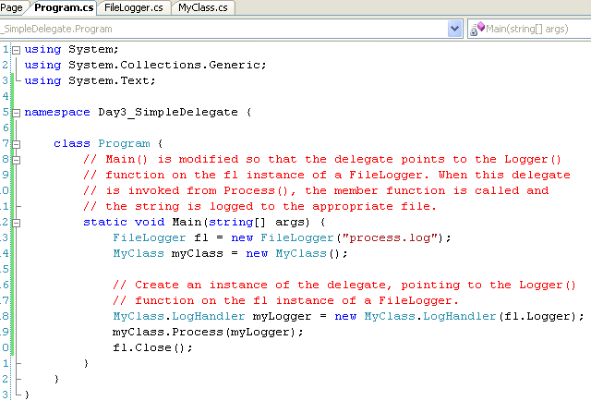
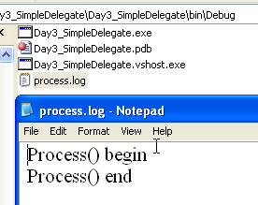
Delegate As function parameters Demo….

Slide 26
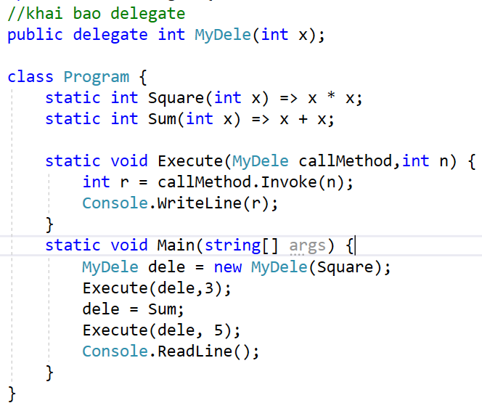
Demo 1

Slide 27
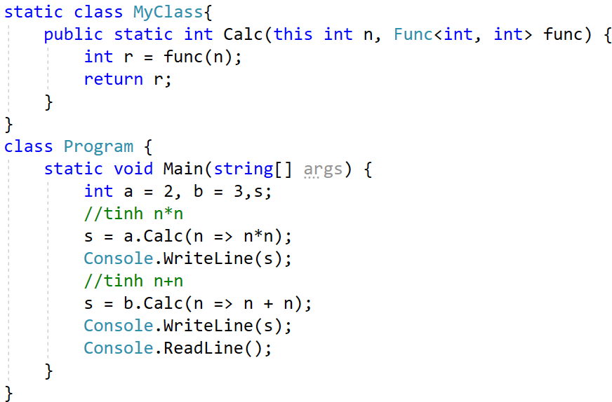
Demo 2

Slide 28
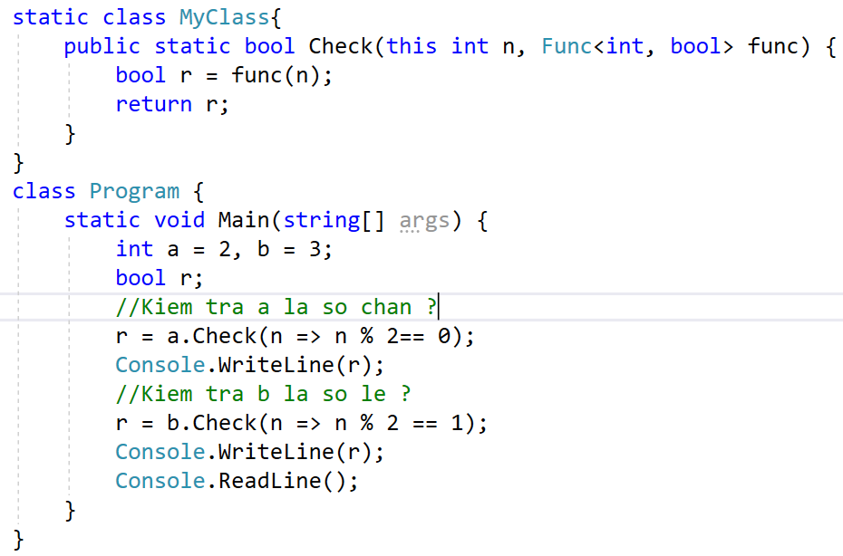
Demo 3

Slide 29
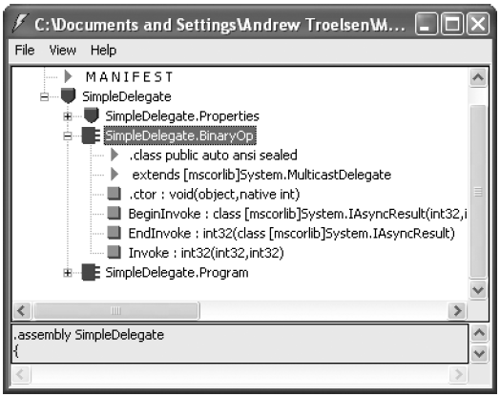
.NET Delegate Type
ildasm.exe tool
The C# delegate keyword represents a sealed type
deriving from System.MulticastDelegate

Slide 30
.NET Delegate Type
Invoke() is used to invoke each method maintained by the delegate type in a synchronous manner
meaning the caller must wait for the call to complete before continuing on its way
BeginInvoke() and EndInvoke() provide the ability to call the current method in an asynchronous manner (on a second thread of execution)

Slide 31
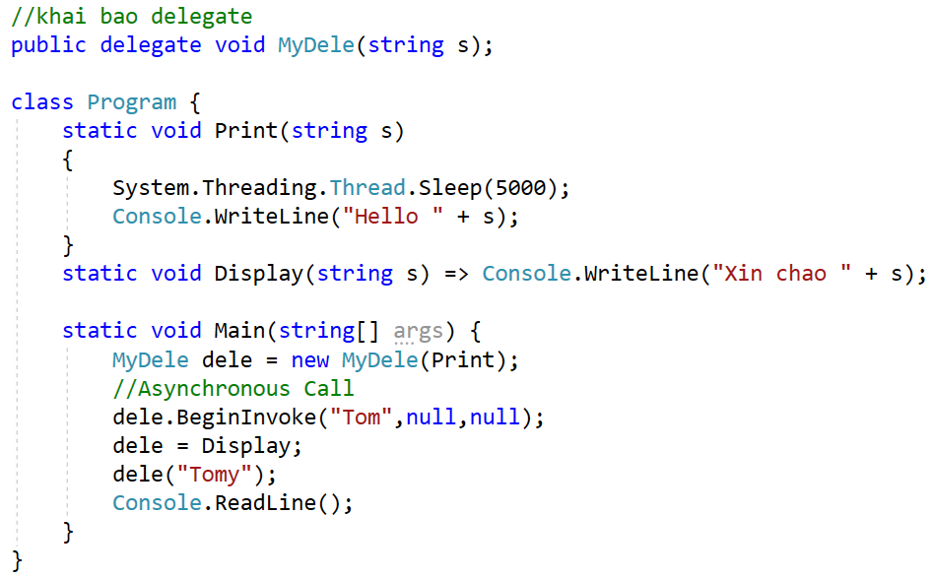
Asynchronous call

Slide 32
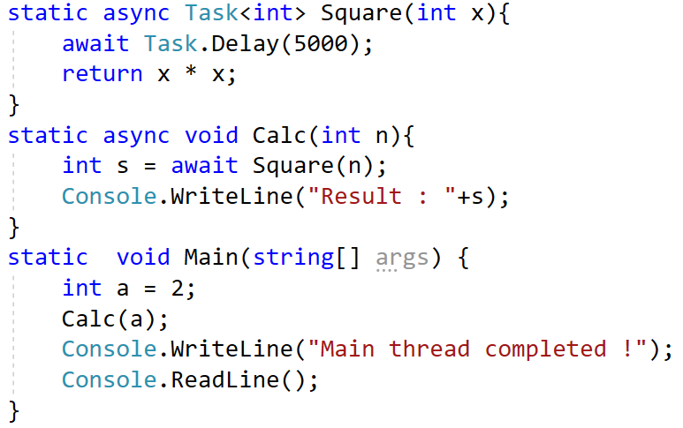

Asynchronous call

Slide 33
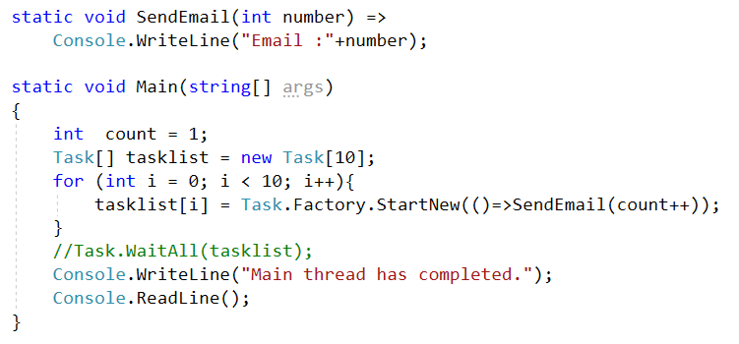
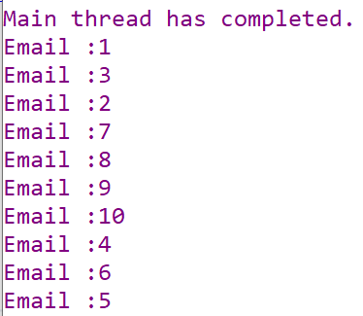
Demo 5

Slide 34
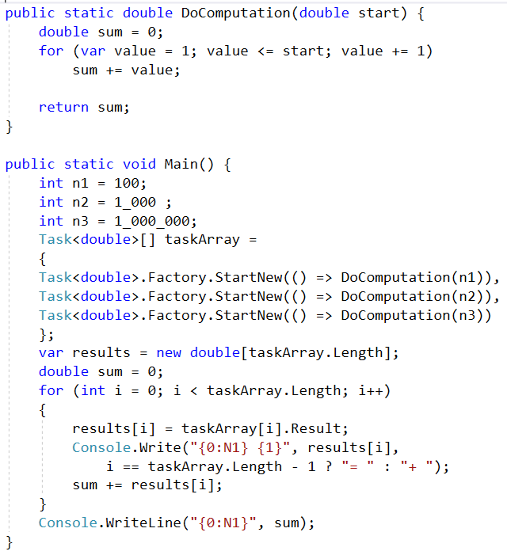
Demo 6

Slide 35
System.MulticastDelegate and System.Delegate Base classes
Inherited Member | Description
Method | represents details of a static method that is maintained by the delegate.
Target | returns an object that represents the method maintained by the delegate. If the value returned from Target equals null, the method to be called is a static member.
Combine() | adds a method to the list maintained by the delegate.
GetInvocationList() | returns an array of System.Delegate types, each representing a particular method that may be invoked.
Remove() RemoveAll() | removes a method (or all methods) from the invocation list.
Select Members of System.MultcastDelegate/System.Delegate

Slide 36
Multicasting Delegates

Slide 37
Multicasting Delegates…

Slide 38
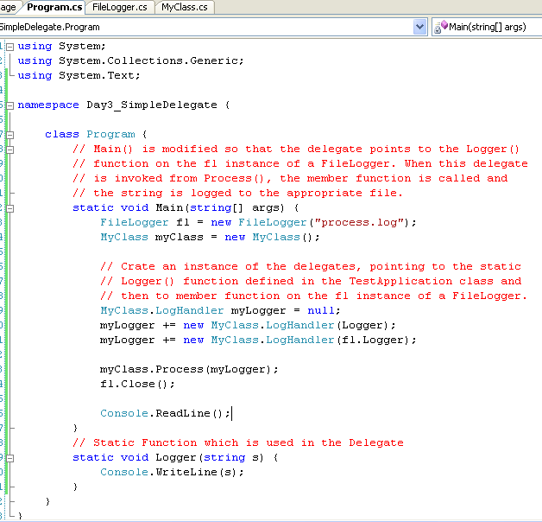
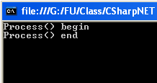
Multicasting Delegates…
More multicasting example: Ch_08 Code\ CarDelegate

Slide 39
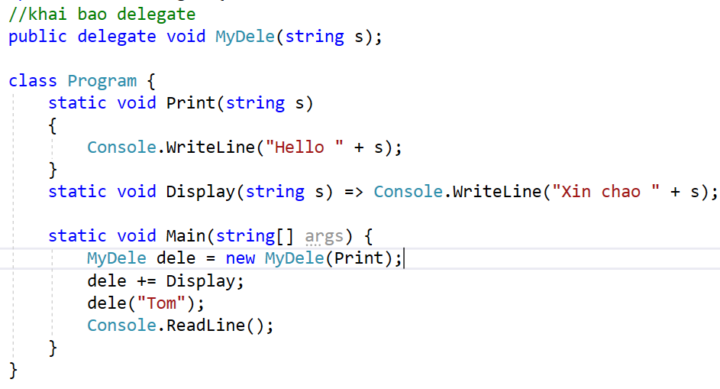

Slide 40
Delegate Covariance
Covariance allows you to create a single delegate that can point to numerous methods that receive objects related by classical inheritance.

Slide 41
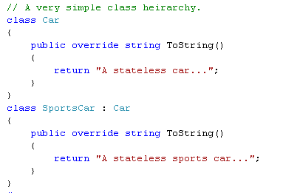
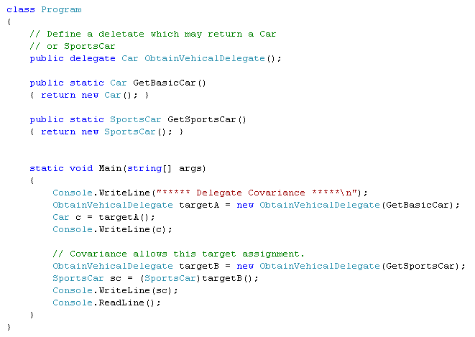
Covariance Demo
We need only one delegate to call 2 methods with different object return type

Slide 42
Understanding C# Events
Using event keyword, the registration and un-registration methods as well as any necessary member variable delegate types are done automatically.
Defining an event is a two-step process:
First, define a delegate that contains the methods to be called when the event is fired.
Next, declare the events (using the C# event keyword) in terms of the related delegate.
public class SenderOfEvents
{
public delegate retval AssociatedDelegate(args);
public event AssociatedDelegate NameOfEvent;
}

Slide 43
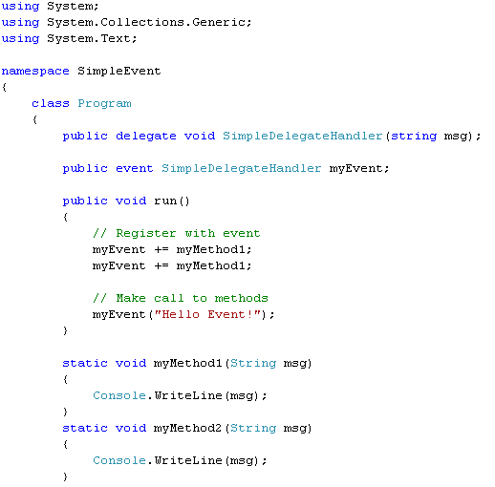
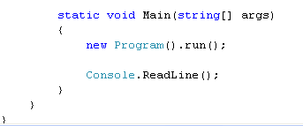

Simple event example

Slide 44
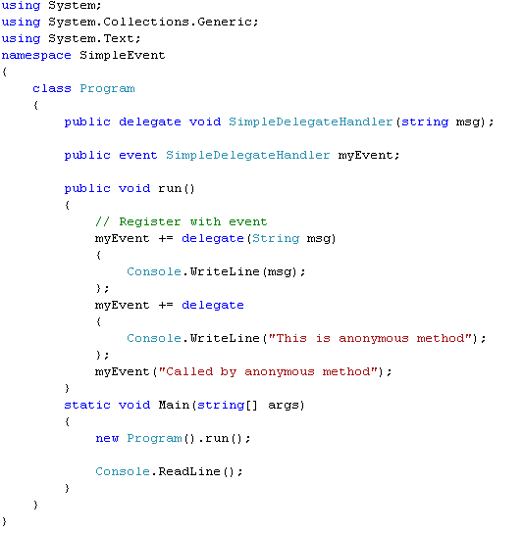

Anonymous Methods

Slide 45
Chapter 8: Summary
A delegate type maintains three important pieces of information:
The name of the method on which it makes calls
The arguments (if any) of this method
The return value (if any) of this method
Invoke(), BeginInvoke() and EndInvoke()

Slide 46
Chapter 8: Q & A

Slide 47
Chapter 10: Understanding Generics

Slide 48

Boxing, Unboxing, and System.Object Relationship
boxing
Un-boxing

Slide 49
Problem with (Un)Boxing Operations
The performance issues
1. A new object must be allocated on the managed heap.
2. The value of the stack-based data must be transferred into that memory location.
3. When unboxed, the value stored on the heap-based object must be transferred back to the stack.
4. The now unused object on the heap will (eventually) be garbage collected.

Slide 50
System.Collections.Generic Namespace
Some of sub items:
ICollection<T>
IComparer<T>
IDictionary<K, V>
IEnumerable<T>
IEnumerator<T>
IList<T>

Slide 51

Generic example
Examining the List<T> Type
Error: cannot add other types

Slide 52


Generic Methods

Slide 53



Default value in Generic
Error
OK
Ex: Ch_10 Code \SimpleGenerics

Slide 54

Constraints for Generic Type
Error??

Slide 55


Constraints for Generic Type
OK
Full example: Ch_10 Code\CustomGenericCollection

Slide 56
Constraints for Generic Type
Generic Constraint | Description
where T : struct | The type parameter <T>must have System.ValueType in its chain of inheritance.
where T : class | <T>must be a reference type.
where T : new() | The type parameter <T>must have a default constructor and must be the last parameter.
where T : NameOfBaseClass | The type parameter <T>must be derived from the class specified by NameOfBaseClass.
where T : NameOfInterface | The type parameter <T>must implement the interface specified by NameOfInterface.

Slide 57

Constraint Example…
Must be the last

Slide 58



Slide 59

The Lack of Operator Constraints
Do not do this
A compiler error will apply any C# operators (+, -, *, ==, etc.) on the type parameters

Slide 60


Slide 61
Chapter 10: Summary
Generic: solve the problem of boxing – un-boxing
Default keyword
Generic constrains

Slide 62
Chapter 10: Q & A

